Slide 1


VIETNAM NATIONAL UNIVERSITY – HCM CITY Ho Chi Minh City University of Technology
Capstone Project: Combine LPSPI, UART, LPIT, ADC Communication With Peripherals On The Register
Instructor : Engineer ĐẶNG NGHĨA NHÂN
Student’s Name : Trần Minh Trí
Class : HCM23_FRF_EMB_09

Slide 2

CONTENTS
Overview
Requirement
Hardware
Software
Reference Documents

Slide 3

Overview
Beginning…!
Toan is a 4th year student at an unnamed B***** university. Recently Toan has been unable to manage his schedule and timelines. It lead to missed deadline and delay working Like a first generation rich kid, Toan wants to design a desk clock for over 200USD. Let’s help Toan build this clock with following requirements !

Slide 4
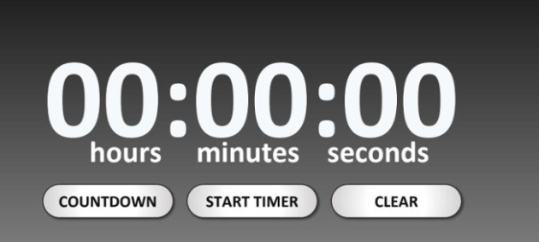
REQUIREMENTS
1 . 1 . BASIC REQUIREMENTS
Press Button 1 :
Display time
Display date
Press Button 2 :
Turn off display mode
Turn on display mode
Setting date, time ,display, using UART and SPI serial communication

Slide 5

REQUIREMENTS
1.2 .EXTRA REQUIREMENTS
Use ADC Communication in touch electrodes control Intensity led

Slide 6
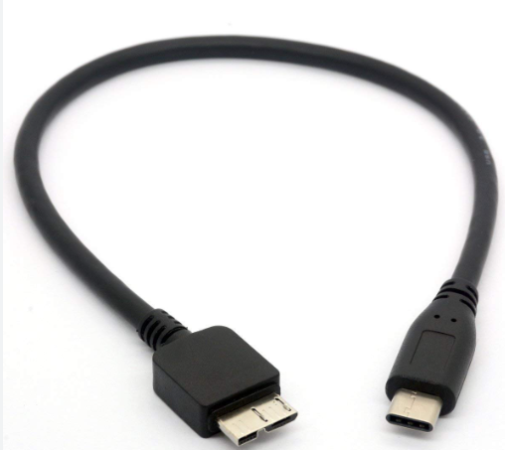
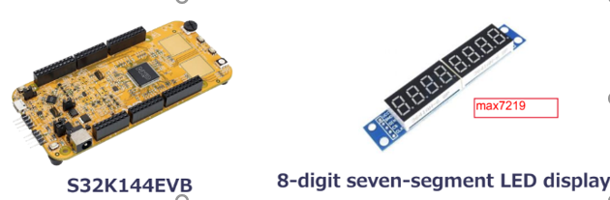
HARDWARE
+ MCU S32K144EVB
+ 1 OpenSDA USB Support Uart communication
+ 8-digit seven-segment LED display
USB TypeC

Slide 7
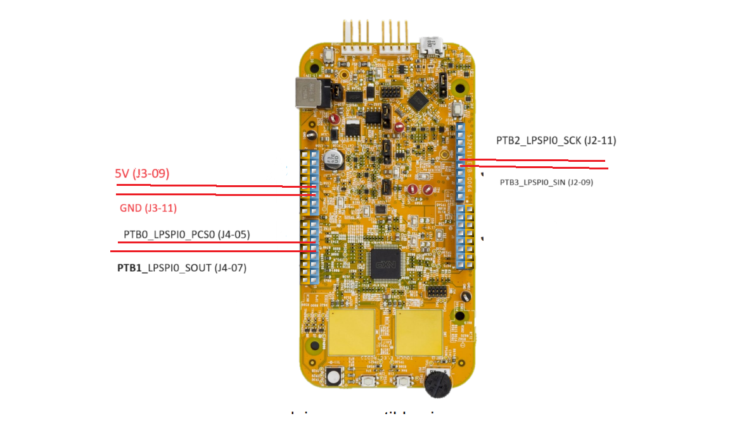
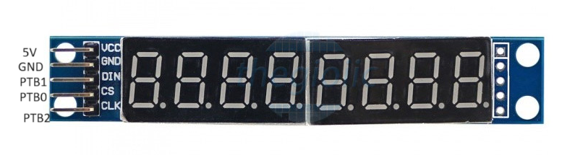

HARDWARE DESIGN
5V Supply for MCU
Send user data to MCU

Slide 8
SOFTWARE
2.1 Peripheral initialization parameters
. Initialize LPSPI Master and Slave :
Master | Data
Clock | 1MHz
CPOL-CPHA | 0-0
Frame Data | 16bit
Type of Transfer | MSB
No Stall | Enable
Mode | Master

Slide 9
SOFTWARE
2.1 Peripheral initialization parameters
. Initialize LPSPI Master and Slave :
Slave | Data
Clock | <= 10MHz
Decode-Mode | 8 digits
Frame Data | 16bit
Type of Transfer | MSB
Intensity | 0x00
Scan-limit | Display 8 digit
Display-Test | Normal operation
Shutdown mode | Normal operation

Slide 10
SOFTWARE
2.1 Peripheral initialization parameters
. Initialize LPIT :
LPIT | Data
Interrupt | Enable
Clock | LPO128_CLK
Channel | Channel 3
Debug Mode | Enable
Time value | 1s

Slide 11
SOFTWARE
2.1 Peripheral initialization parameters
. Initialize Button:
LPIT | Data
Interrupt | Enable
PORT | C
MUX | GPIO
ISF | Falling-edge
Direction | Input

Slide 12
SOFTWARE
2.1 Peripheral initialization parameters
. Initialize LPUART :
LPUART1 | Data
Source Clock | FIRCDIV2_CLK = 48 MHz
Interrupt | Enable
Baud Rate | 9600
Frame Data | 1 start bit – 8 bit data – 0 parity -1 stopbit

Slide 13
SOFTWARE
2.1 Peripheral initialization parameters
. Initialize ADC:
ADC0 | Data
Source Clock | FIRCDIV2_CLK = 48 MHz
Resolution | 12bit
Conversion Mode | Continuous conversions
Chanel | PTC1 –ADC0_SE9

Slide 14
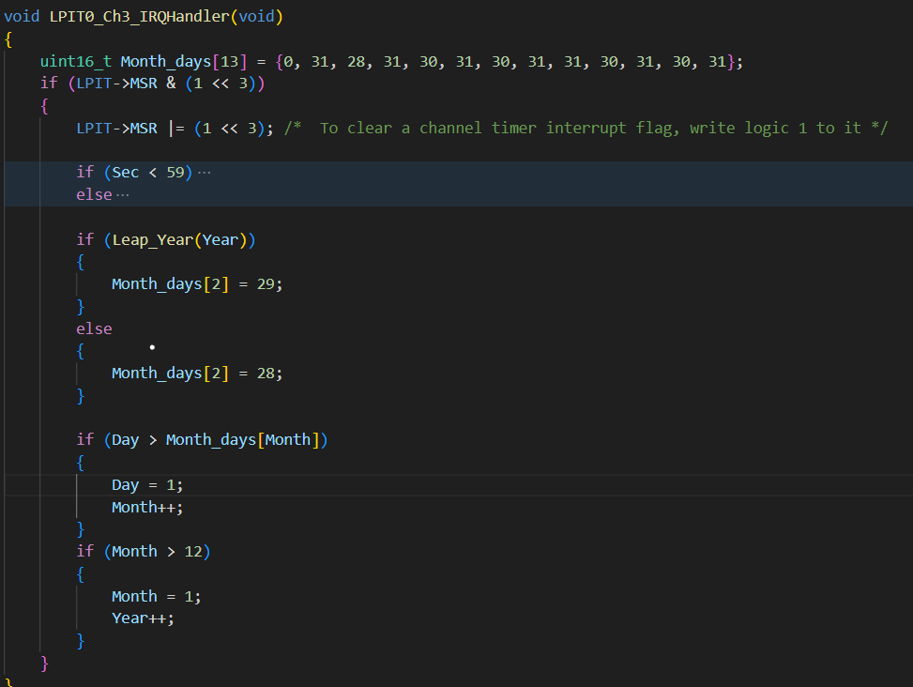
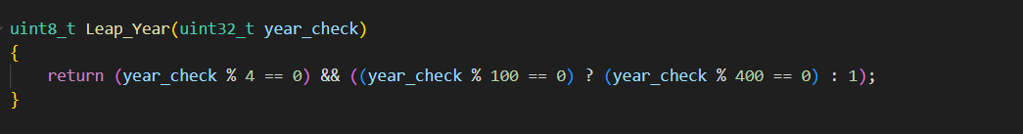
SOFTWARE
2.2 Logic Code

Slide 15
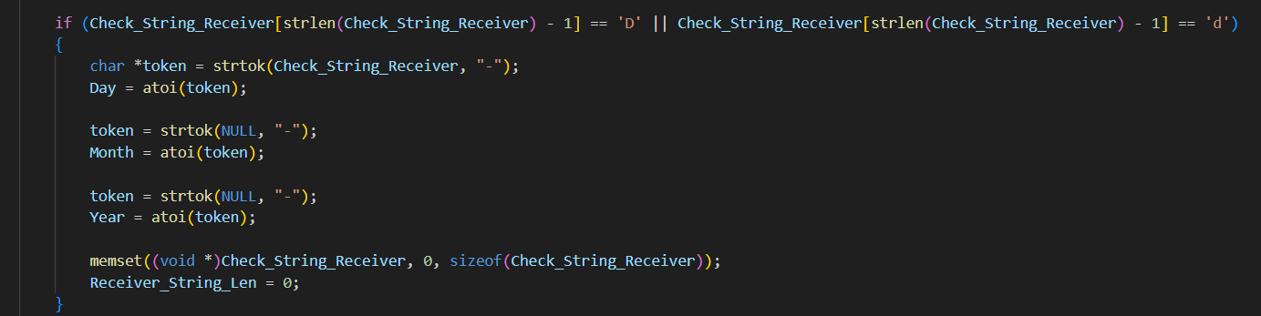
SOFTWARE
2.2 Logic Code

Slide 16
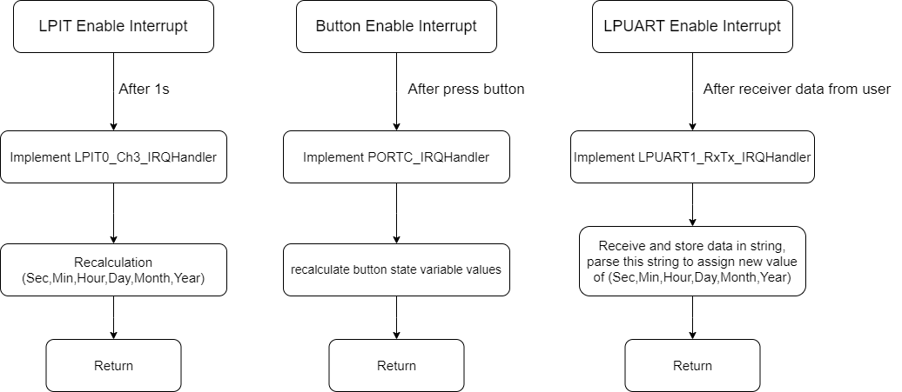
SOFTWARE
2.3Flow Chart

Slide 17
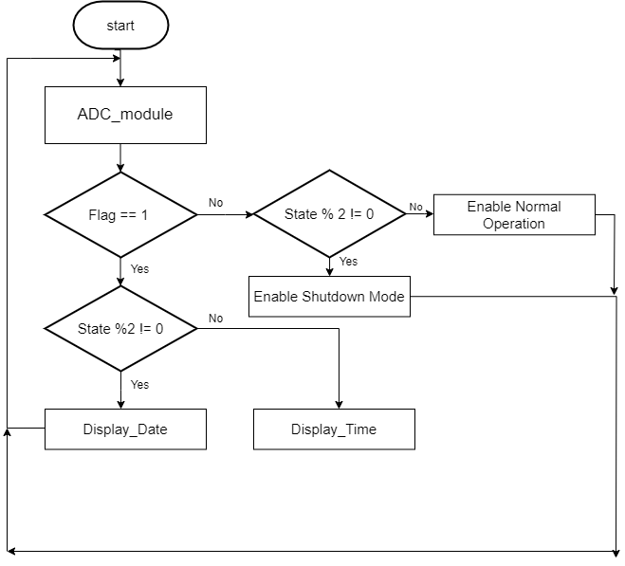
SOFTWARE
2.3Flow Chart

Slide 18
REFERENCE DOCUMENT
https://www.analog.com/media/en/technical-documentation/data-sheets/max7219-max7221.pdf
https://classroom.google.com/c/NjMzNDUyNzY5MzYz/m/NjM3NTc1NTQ3MjA2/details
https://www.facebook.com/toan.tranzr3902

Slide 19

Q & A

Slide 20

THANKS FOR LISTENING

